Slide 1

Specialization
Dotnet Core 2.0, ASP.Net Core 2.0
C# 7.0, WPF 4.5 .2 with Blend
ASP.Net MVC 2.0 & Micro services
WCF 4.5.1, Web API, WF 4.5.1
Machine learning with Python & DJango
DevOps, GIT, Jenkins, Docker
MEAN stack and MERN stack
UML 2 and OOAD
HTML 5, CSS 3, SASS, Bootstrap
65 .Net Design Patterns
ES 6, Jquery 3.x,D3.js
Aurelia, Post CSS, Lost Grid, AMD
Typescript, Angular 7.0 / 8.0
Haxe , Vue js, Oracle Jet, Open UI 5
Metal js, React & Redux , Mobx
Ext JS 6, Backbone ,Kendo UI,
Node js, Mongo DB & Restify
Mocha, Jasmine,Protractor, Karma
Docker, Webpack, Grunt, Gulp,
Angular 8.x
D.S.R.Murthy M.Tech (IT)
Software Architect & Corporate Trainer
Experience : 28 years
Notes:
http://www.syntaxsuccess.com/angular-2-samples/#/about
http://angular-tips.com/blog/2015/05/an-introduction-to-angular-2/
Angular2js.com

Slide 2
Explain
Goto \\192.168.1.99
Download angularapp.zip from angulartrainingshare
Unzip angularapp.zip.
Open angularapp inner-folder into VS Code IDE.
Click View→Terminal in VS Code to see cmd prompt.
Type : ng serve (to start the server)
Open Google Chrome browser and type url:
localhost:4200 (enjoy the output)

Slide 3
Lab Setup
Windows 8/10.x
Node js >10.x (10.x is better)
Visual Studio code (IDE)
Google chrome browser
Augury chrome extension for debugging angular app
Install angular CLI
npm install –g @angular/cli
type above line in command prompt)

Slide 4
Lab Setup
npm install –g @angular/cli
ng - -version
ng new angularapp
Open angularapp in VS Code by choosing open folder
In VS Code, Open view→Terminal
ng serve - -open
localhost:4200

Slide 5

GOOD MORNING
Notes:
Create work folder in C drive then, npm install @angular/cli
Set path : c:\work\node_modules\bin
C:\work> ng new myapp
c:\work> cd myapp
C:\work>ng serve
(open browser and type localhost:4200)

Slide 6




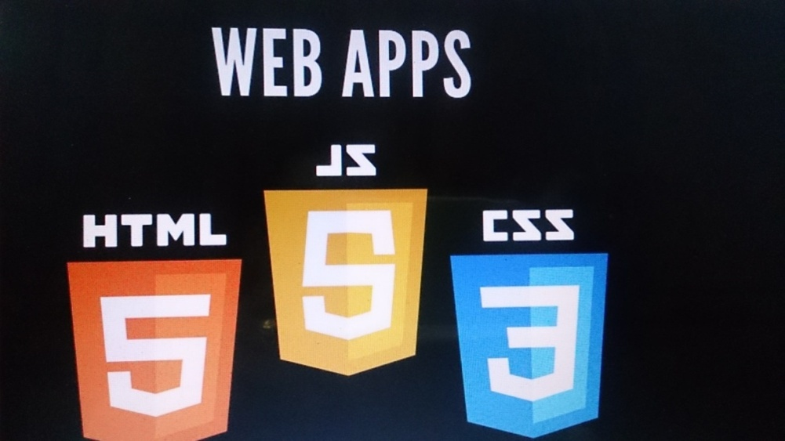
Web Challenge Now
HTML 5
CSS 3
JS / TS
Single Page App
One Structure
One Style
One Code

Slide 7
Angular 7.0 toolchain
Node js >10.16
npm or ng to download modules
Typescript with built-in ES6 support and transpilation
Webpack for build automation
ng-cli for command line interface
Jasmine with Karma test automation
Protractor and selenium for E2E Testing
tslint to validate code to meet coding standards
Bootstrap / Angular material Design for CSS
Visual Studio Code IDE with plugins
Git / Jenkins for continues integration and delivery

Slide 8
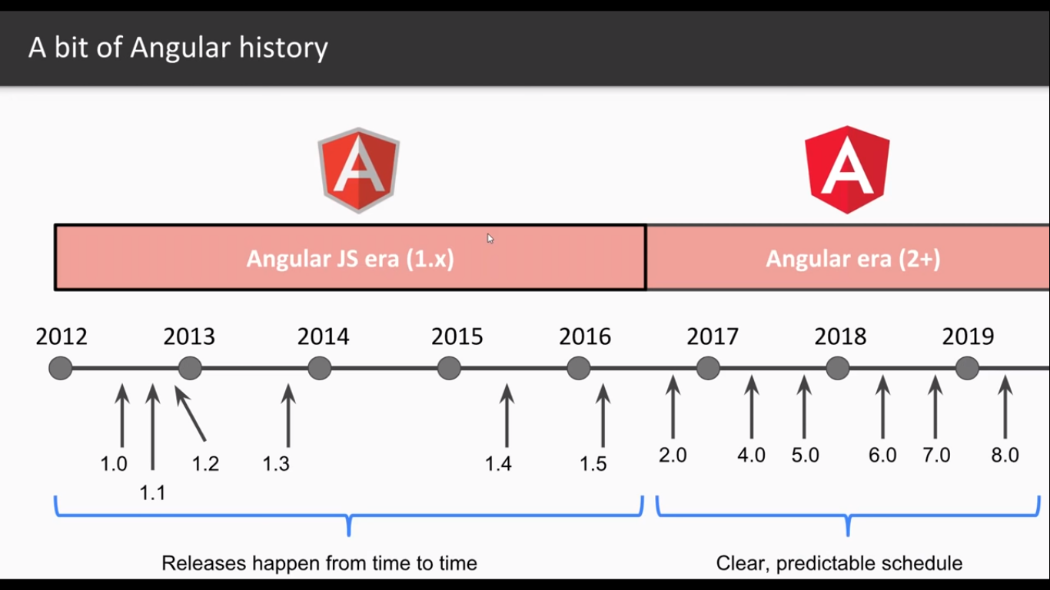
Angular 7

Slide 9
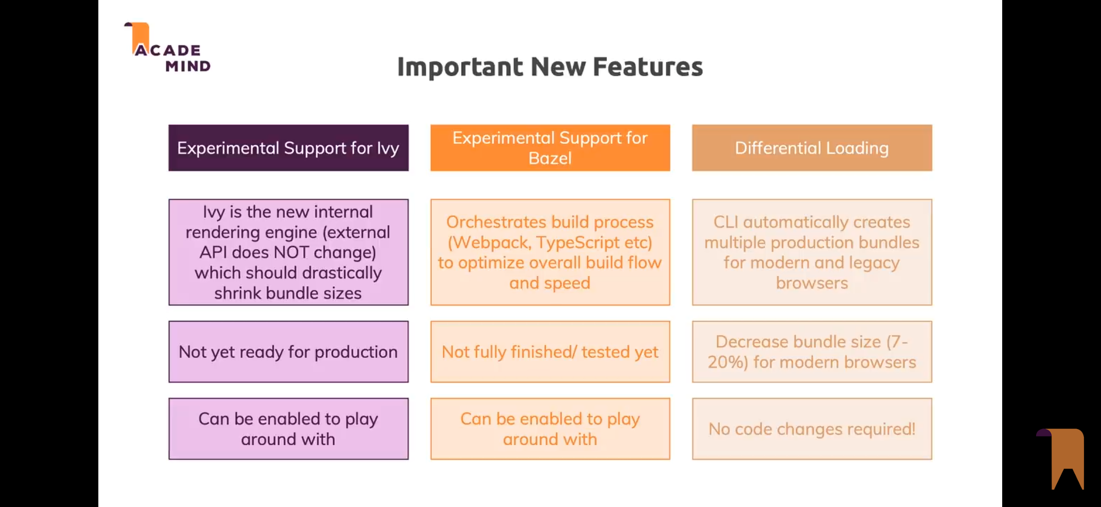
Angular 8

Slide 10
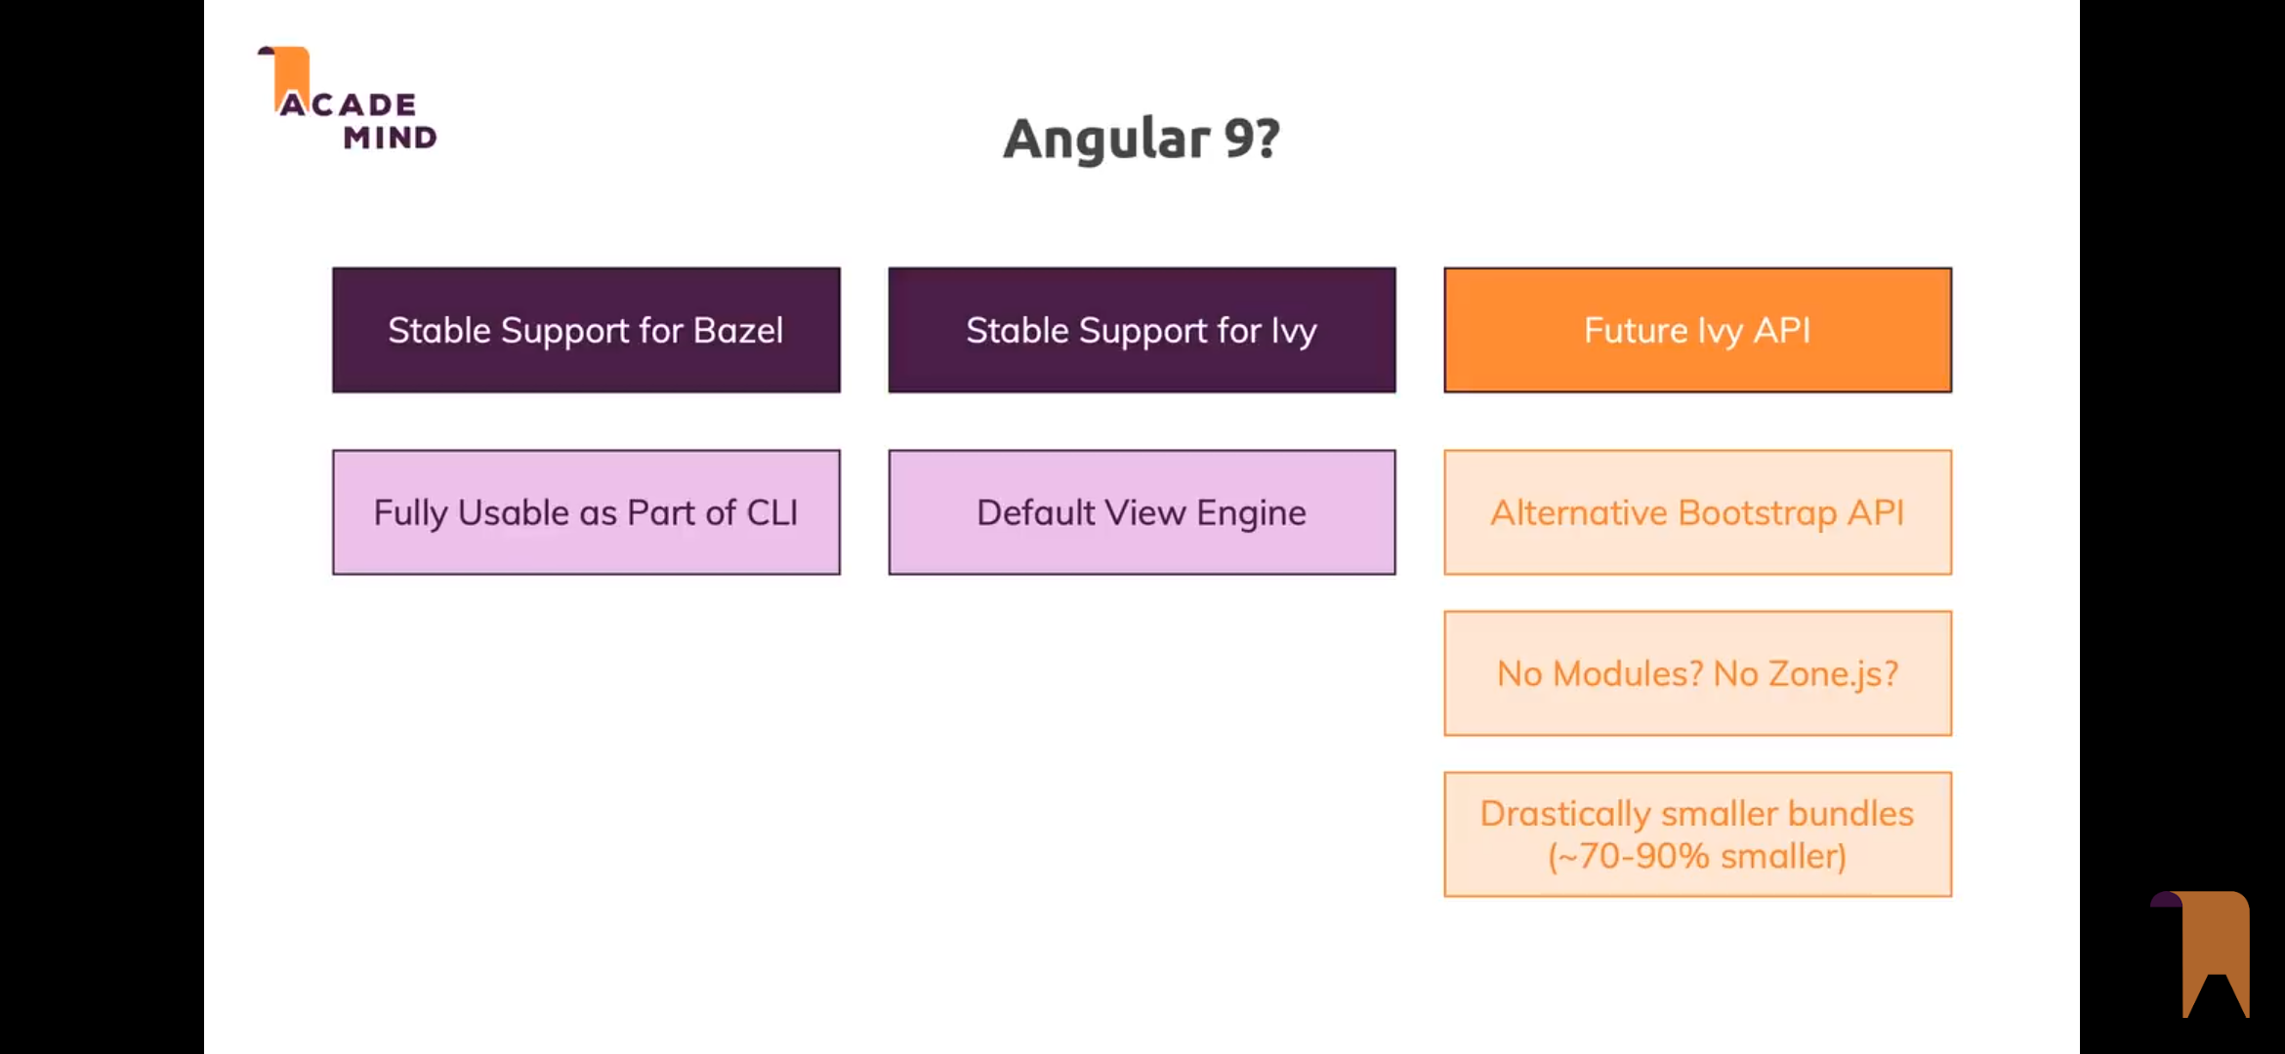
Angular 9

Slide 11
Angular
"
To install ng cli with particular version:
npm install –g @angular/cli@1.6
c:\>ng new angulartraining
c:\>cd angulartraining
c:\>ng serve
Or
Install latest and in package.json, specify version
dependencies": { "@angular/animations": "^4.3.4", "@angular/common": "^4.3.4“…..
npm install
ng -v
Notes:
C:\users\murthy\appdata\roaming\npm> ng –version
…..ng new angularapp

Slide 12
Angular
Build-optimizer
Angular Universal State Transfer API and DOM Support
Compiler Improvements
Internationalized Number, Date, and Currency Pipes
Zone speed improvements
HttpClient module enhancement
Angular Forms adds updateOn Blur / Submit with multi-validators support in Formbuilder
New Router Lifecycle Events
Typescript 2.7+ support

Slide 13
Angular 6.0
RxJs 6.0 library used now (Breaking change)
npm install rxjs-compat (for backward compatibility)
Optional Bazel compiler used which compiles only necessary code which optimizes dependency analysis and support parallel execution. (For SSR)
Web component support (Angular Elements)
Ivy Renderer rendering engine optimizes final package
Angular-cli.json renamed to angular.json in biolerplate
Stable Angular Material with CDK
(Component Development Kit)

Slide 14
Developer / Architectural Challenges
IDE support for Scripting with intellisence and Type Checking
Pure Object Oriented Programming (Like Java /C#)
Fast rendering of DOM
Cross Browser Support
High Performance
Ease of Maintenance and Clean code
Mobile Support
Loosely coupled with Separation of Concerns and Extensibility (DI)
Modular for Testability (Automated Testing support)
Responsive Rendering
Server side build for production use (Pre JIT) - AoT

Slide 15
Libraries and Framework
Jquery → Library for DOM manipulation and Ajax
Backbone JS → MVC /MVVM framework (Template: handlebar.js)
Kendo UI→ MVC .MVVM framework from Telrik for Rich UI
Ext JS → MVC/MVVM framework offer Rich UI components but heavy weight and does not be integrated with other frameworks.
Ember JS → MVC/MVVM framework with code conventions
React JS→ View library created by Facebook for Reactive SPA
RxJS → Observable collections to work with asynchronous data streaming
Node js → Runtime environment with server side java script
Grunt , Gulp , Webpack → Build Automation tools
Jasmine, Mocha → Unit Testing Frameworks
Karma → Test Runner for automating tests

Slide 16

Is Jquery Suitable?
Jquery not suitable for Enterprise app
(not modular /high complexity and maintenance)

Slide 17
Solution
React from Facebook
Angular from Google
Oraclejet , Aurelia , Vue.js

Slide 18

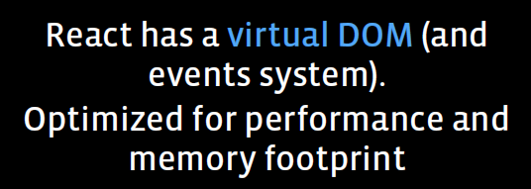
Angular
Shadow DOM
Angular 2.0 / 4.0 is java script framework to create reactive Single Page Applications for Mobile/Desktop
Angular Goal :
Building large applications with data
that changes over time.

Slide 19
Angular 1.x vs Angular
Angular 1.x
Service
Factory
Controller
Provider
Directive
Values
Constants
Filters
Angular 4.0
Module
Component
Service
Template
Directive
Data Binding
Pipes
DI

Slide 20
Angular JS vs Angular
Module (Require JS) → Module (System JS)
Service with DI → Service with DI (improved)
Factory → No Factory
Controller → Controller class in Component
Directive → Structural/Attribute Directives
Filters → Pipes
Values → Model class of Typescript
Constant → const of ES6 / Typescript
Providers → Improved providers
Routing → Routing ( Improved)
Work with DOM → Work with Shadow DOM
Written in ES5 → Written in ES6 / Typescript
Works with promise → Works with Observable (RxJS)

Slide 21
Components
6

Slide 22
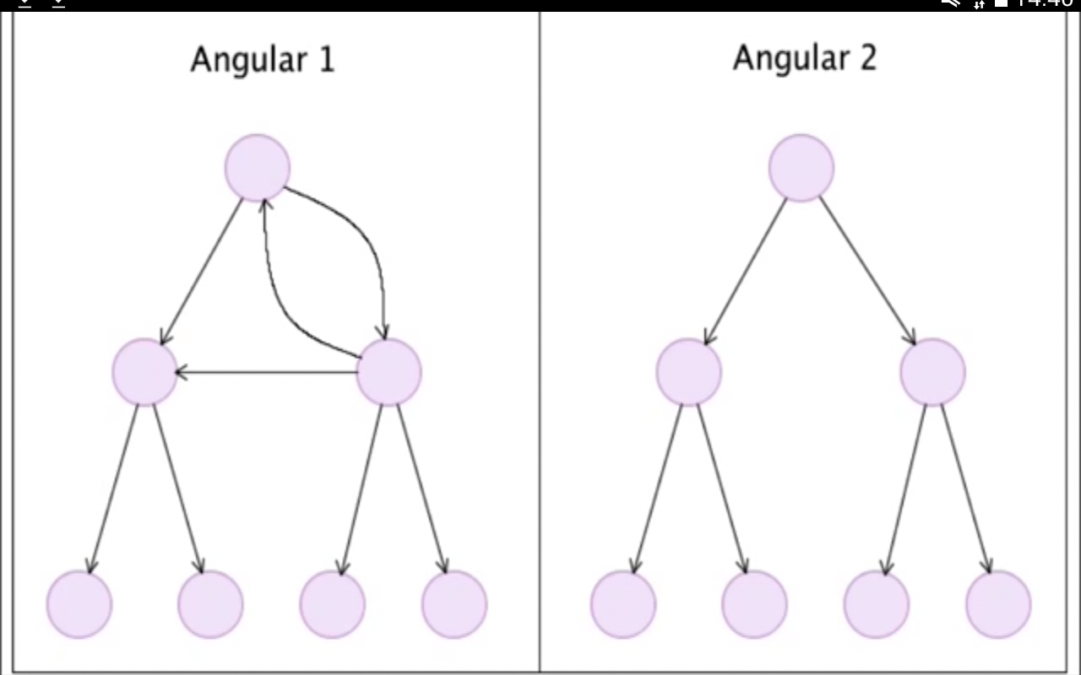
Angular 1.x vs Angular – Data Flow
8
MVC & MVVM
Uni-directional Data Flow

Slide 23
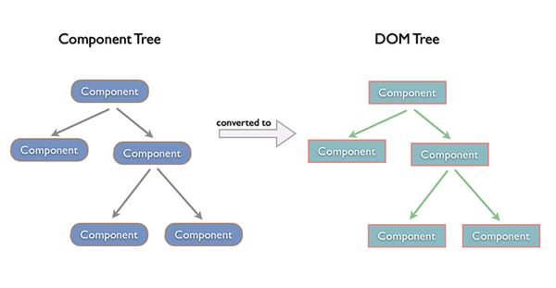
Angular – Shadow DOM

Slide 24
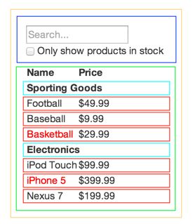
Unidirectional Data Flow
FilterableProductTable
SearchBar
ProductTable
ProductCategoryRow
Product
Single Responsibility Principle
Design components to be responsible for only one thing.

Slide 25
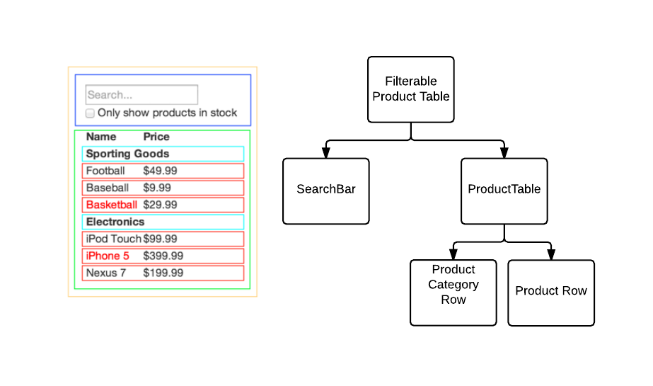
Unidirectional Data Flow
Product

Slide 26
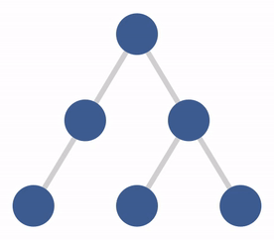
Unidirectional Data Flow

Slide 27
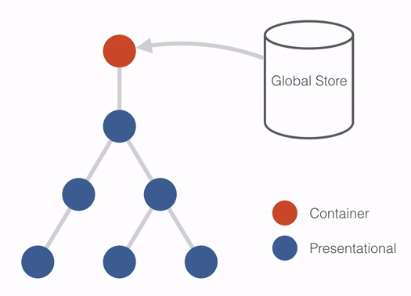
Unidirectional Data Flow

Slide 28
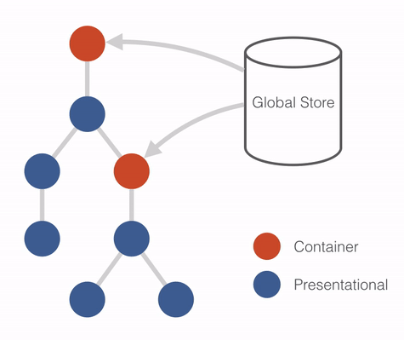
Unidirectional Data Flow

Slide 29

Unidirectional Data Flow
Product

Slide 30
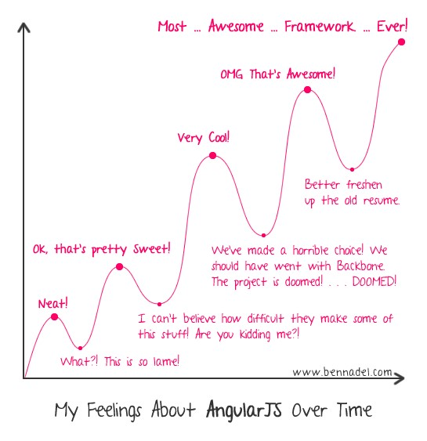
Angular – Smooth Learning Curve

Slide 31
Angular
Editors for Angular
Adobe Brackets
Eclipse
Sublime text 3.0
JetBrains
Microsoft visual studio code or VS 2013/2015
How do I use Typescript
Command line
IDE /Editor
Gulp/grunt
Webpack

Slide 32
Angular Boilerplate and Compilers
Boilerplate tools:
-Plunker
- NG2-PLAY
- YEOMAN GENERATOR
- SLUSH GENERATOR
- WEBPACK
- JSPM
Compilers :
- Babel
- Typescript 1.5
- Traceur

Slide 33
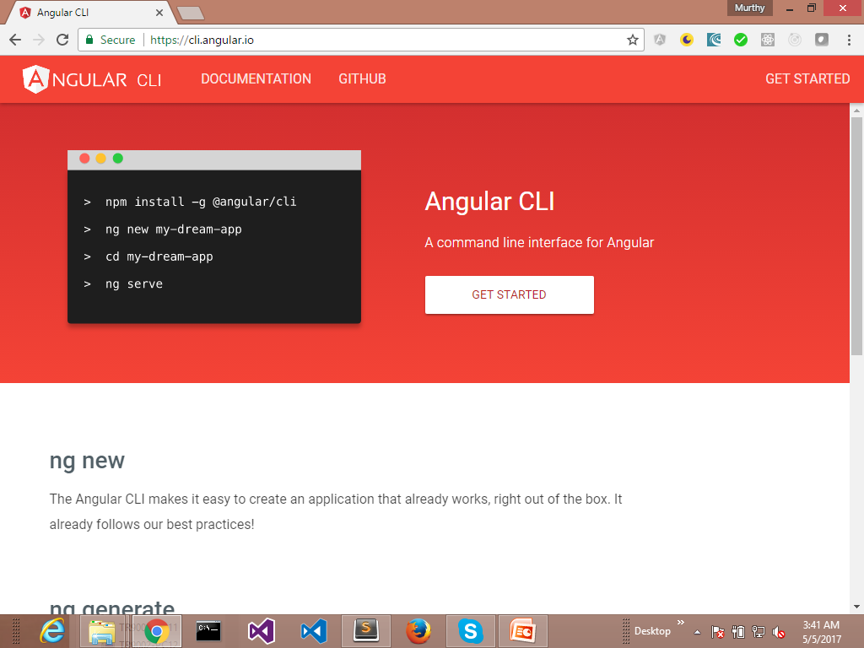
Angular 2.0 with gulp

Slide 34
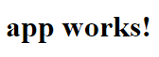
Setting up Angular
Step 1. Set up the Development Environment
$ npm install -g @angular/cli
Step 2. Create a new project
$ ng new my-app
Step 3: Serve the application
$ cd my-app
$ ng serve - -open

Slide 35
Angular Libraries
core-js
Patches the global object (window) with essential features of ES2016 (ES6).
rxjs
Reactive Extensions Library for JavaScript,
which includes methods for transforming, composing, and querying streams of data.
It is utilized by several parts of the Angular framework's HTTP and Forms modules.
The library provides an Observable implementation.

Slide 36
Angular Libraries
zone.js
Zone.js provides the mechanism to hook into asynchronous operations and track outstanding async tasks.
Angular does that by creating its own NgZone which waits until all asynchronous operations like timers and XHR requests are completed and triggers change detection.

Slide 37
Angular Libraries
@angular/core
Critical run-time parts of the framework needed by every application.
Includes all metadata decorators, Component, Directive,
dependency injection, and the component life-cycle hooks.
Contains core functionality component views, DI and change detection.
@angular/compiler
Angular’s Template Compiler. It reads your templates and can convert them to code that makes the application run and render.
Compiler is used indirectly via platform-browser-dynamic.

Slide 38
Angular Libraries
@angular/common
Provides the commonly needed services, pipes, and directives such as ngIf and ngFor.
@angular/platform-browser
Contains the functionality to bootstrap the application in a browser.
It includes everything DOM and browser related,
pieces that help render into the DOM.

Slide 39
Angular Libraries
@angular/platform-browser-dynamic
Contains implementations for the dynamic bootstrap of the application.
Includes providers and a bootstrap method for applications that compile templates on the client
Use this package for bootstrapping your application during development (in production, we use bootstrapStatic)

Slide 40
Angular-CLI
ng new
The Angular2 CLI makes it easy to create an application that already works, right out of the box. It follows our best practices!
ng generate
Generate components, routes, services and pipes with a simple command. The CLI will also create simple test shells for all of these.
ng serve
Easily put your application in production
Test, Lint, Format
Run your unit tests or your end-to-end tests with the breeze of a command. Execute the official Angular2 linter and run clang format.

Slide 41
Angular-CLI
Install Node js from nodejs.org
npm install -g @angular/cli
ng help
Generating and serving an Angular2 project via a development server
ng new PROJECT_NAME
cd PROJECT_NAME
ng serve
Navigate to http://localhost:4200/. The app will automatically reload if you change any of the source files.
You can configure the default HTTP port and the one used by the LiveReload server with two command-line options :
ng serve --host 0.0.0.0 --port 4201 --live-reload-port 49153

Slide 42
Angular-CLI
Scaffold usage
Component ng g component my-new-component
Directive ng g directive my-new-directive
Pipe ng g pipe my-new-pipe
Service ng g service my-new-service
Class ng g class my-new-class
Interface ng g interface my-new-interface
Enum ng g enum my-new-enum
Module ng g module my-module
Creating a build
ng build

Slide 43
Angular Dev. Tool for Debugging- Augury
Angular Augury is a Google Chrome developer tool extension for debugging and profiling angular2 applications.
(https://augury.angular.io)
Augury helps developer to :
Visualize the application through component tree
Visual Debugging
See the application structure
Visualize Change detection
Check Performance characteristics
Source code debugging with on typescript with breakpoint.
Use Watchers, immediate window, console window,XHR ….

Slide 44
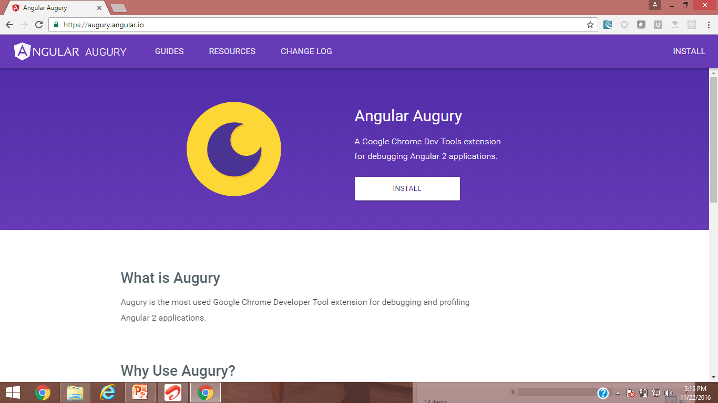
Angular 2.0 with gulp

Slide 45
Structure of Angular Applications
● src
+---● app
| +--● employees
| | |--employees.component.ts|.html|.css
| | +--● employee
| | | |--employee.component.ts|.html|.css
| | |
| | +--● employee-list
| | | |--employee-list.component.ts|.html|.css
| | |
| | +--● shared
| | |--employee.service.ts
| | |--employee.model.ts
| |
| |--app.module.ts
|
|--index.html (cdn path for bootstrap and font-awesome icon)

Slide 46
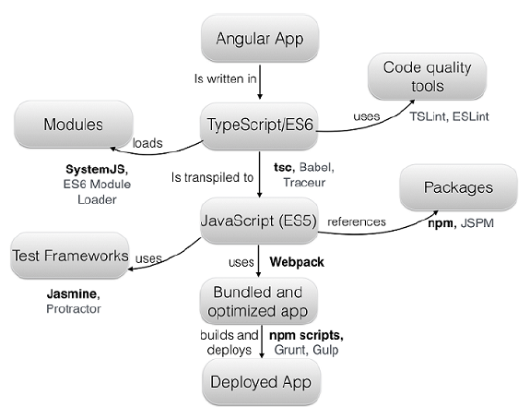
Angular - Tools Chain

Slide 47
Architecture of Angular
Building Blocks of angular
Module
Component
Template
Data Binding
Service
Directive
Dependency Injection
Pipes

Slide 48
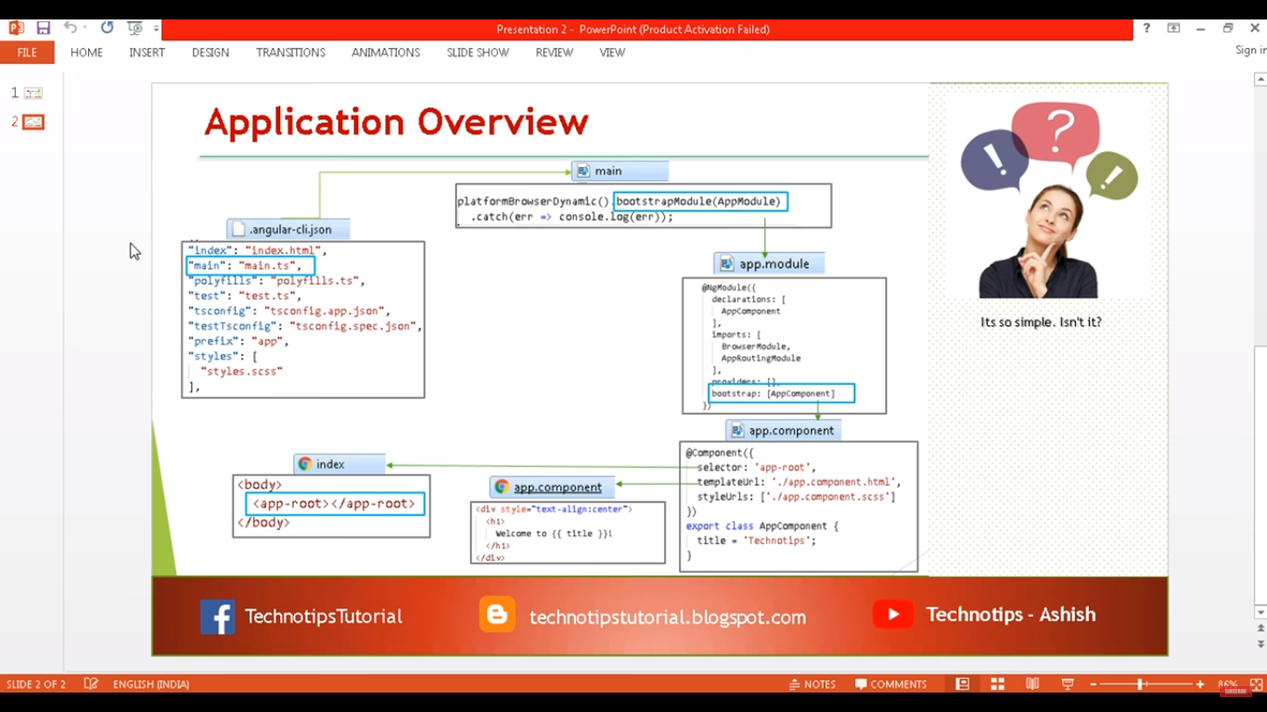

Slide 49
Architecture of Angular
NgModule
(metadata)
AppModule
Components
Services
Views (.html)
Stles (.CSS)
Services
Directives
Pipes
App.Component.ts
App.Component.html
App.Component.css
App.Service.ts
App.Directive.ts
App.Pipes.ts

Slide 50
Angular App Flow
Entry Point
(main.ts)
(Bootstrap)
AppModule
NgModule
(metadata)
NgModuleFactory
CommonModule
Components
Keep custom module metadata
Views
Index.html

Slide 51
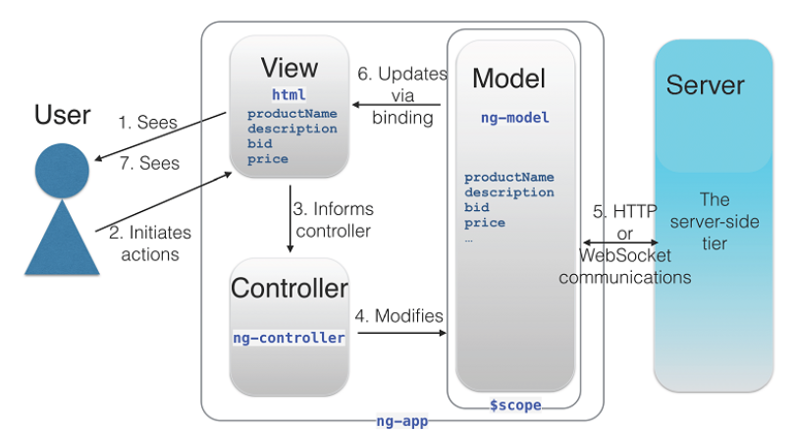
Architecture of Angular 1.x
Notes:
to get the product data, the user loads the application (#1) and enters the
product ID (#2). The view informs the controller (#3), which updates the model (#4) and
makes an HTTP request (#5) to a remote server via the $http service. AngularJS
populates the properties of the model with the retrieved data (#5), and the changes in the
model are automatically reflected in the UI via a binding expression (#6). The user then
sees the data about the requested product (#7).
To display a value of the model’s productName property, you could add the
following HTML template to the view: <p>{{ productName }}</p>. AngularJS will
compile this template into the JavaScript code. The double curly braces will display (and
automatically update) the product name in a view. The changes in the UI are propagated
to the model if the user modifies the product data in the view. This two-directional update
mechanism is called two-way data binding

Slide 52
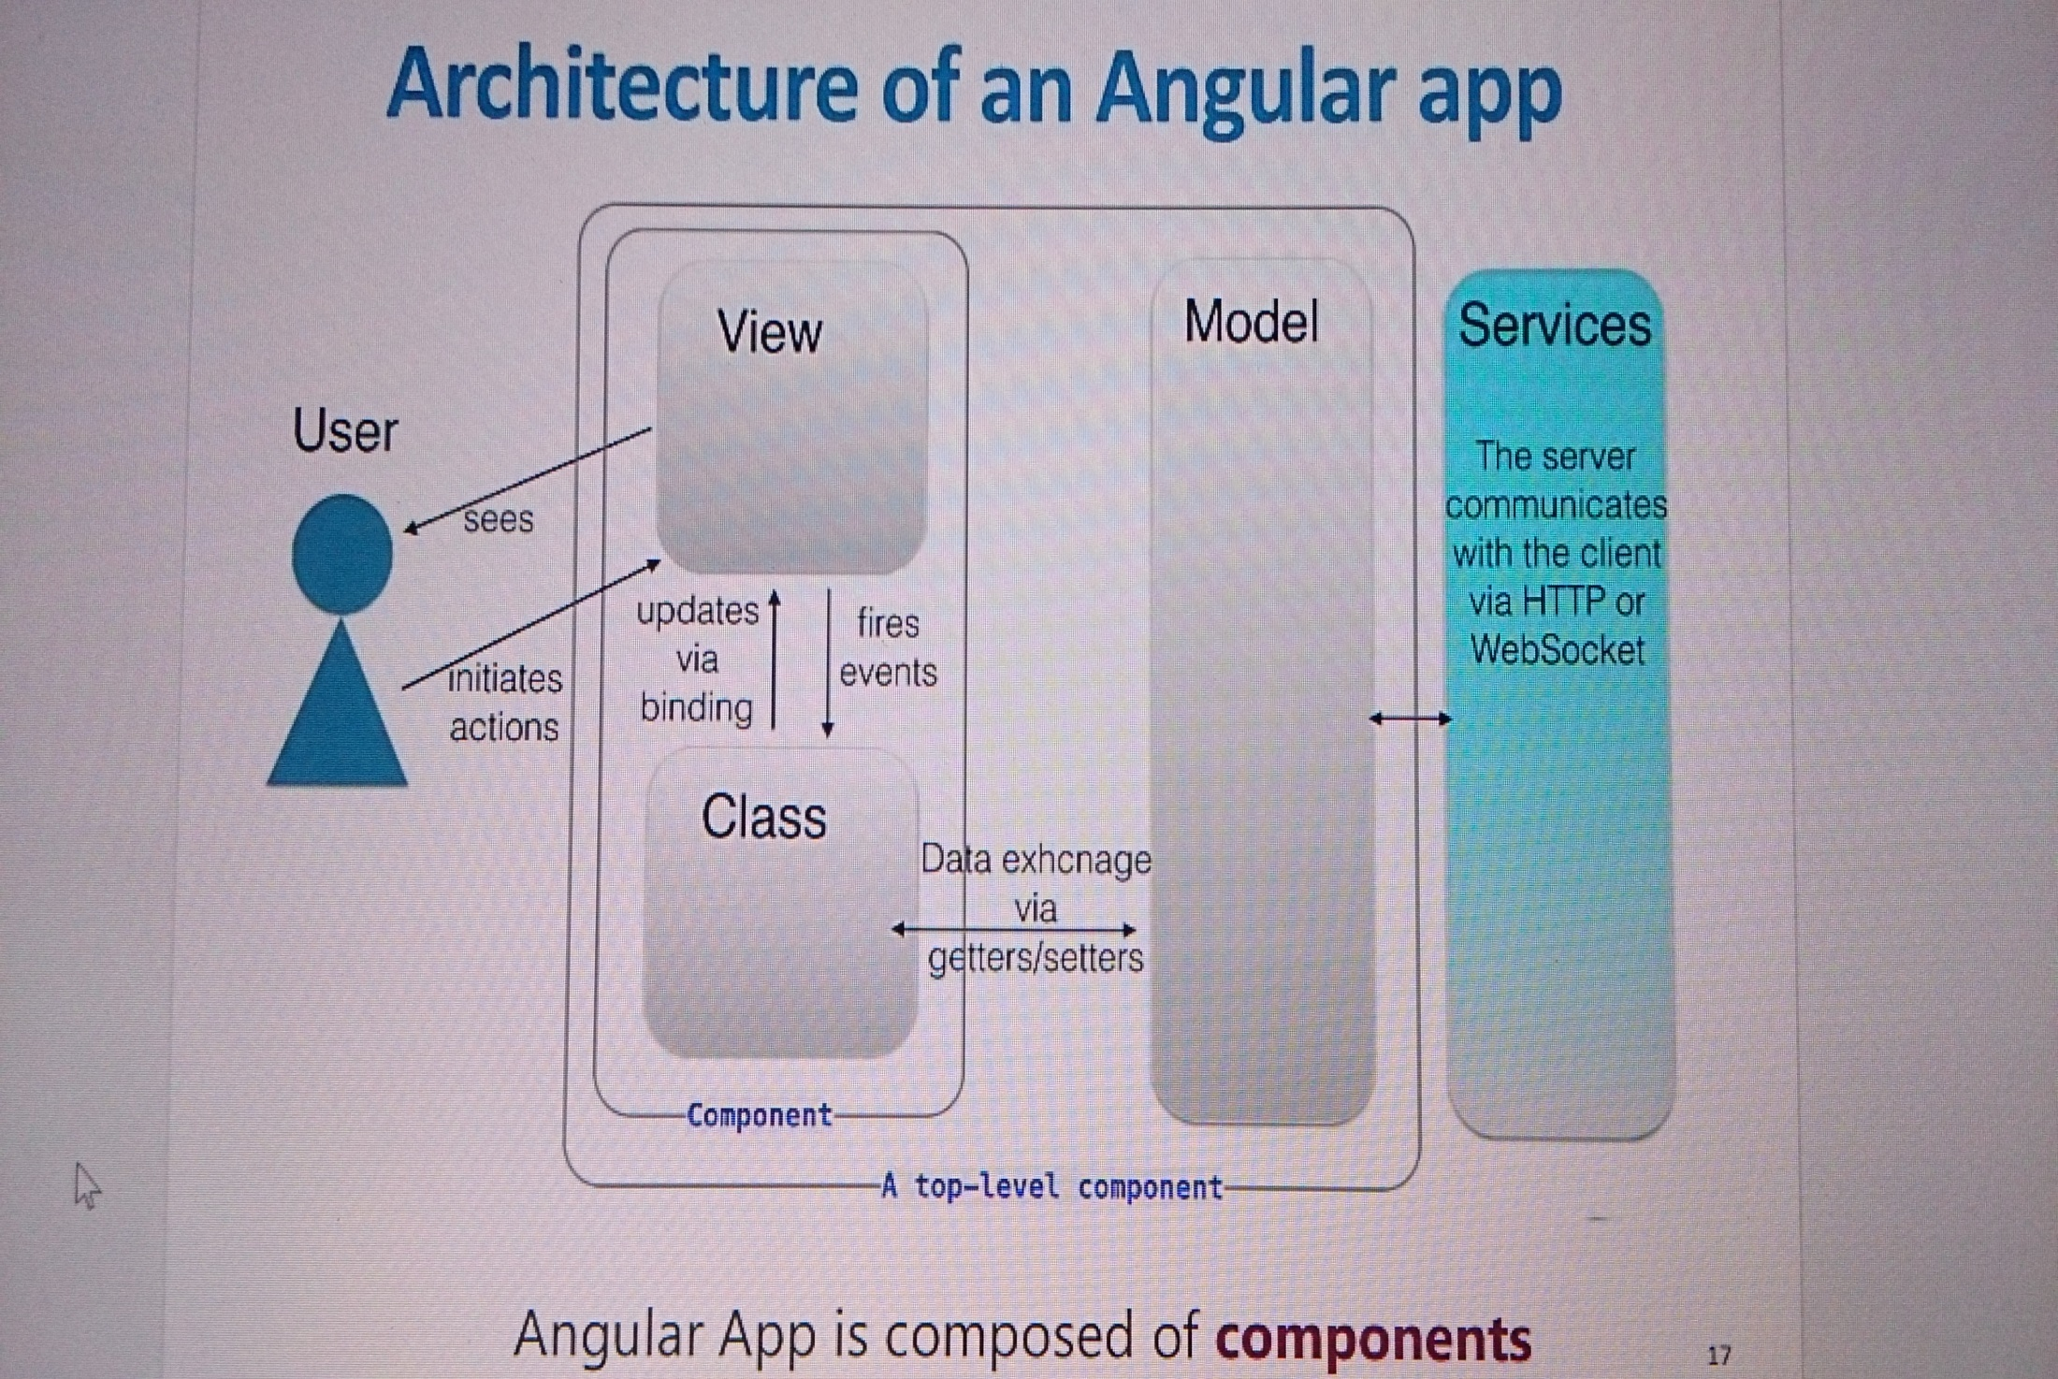
Architecture of Angular 2.0

Slide 53
Module
A Type Script/ES6 module is a way to encapsulate , group, reuse, distribute and load code in JavaScript.
A module will contain code that encapsulates a specific functionality. (one module → one task → one file)
The module will expose this functionality to the rest of the application by defining a series of exports that other parts of the system can then import.
Angular component class can be exported from a module with public access for import.
The core module for Angular is
‘@angular/core' and it gives access to Component.

Slide 54
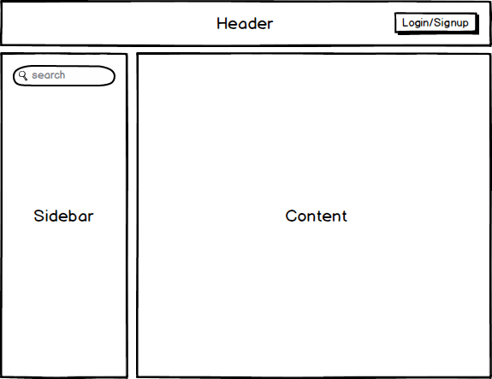
Component

Slide 55
Component
HeaderComponent
Responsibilities
All aspects of authentication. Letting the user login/signup and logout.
Inputs
None
Outputs
LoginChanged — An output event that is fired when the users login state changes.

Slide 56
Component
SidebarComponent
Responsibilities
Performing searches
Inputs
None
Outputs
SearchTermChanged — An output event that is fired when a user performs a search, $event contains the search term.
ContentComponent
Responsibilities
Showing the search results.
Inputs
SearchTerm the search term that we want to filter the results by.
Outputs
None

Slide 57
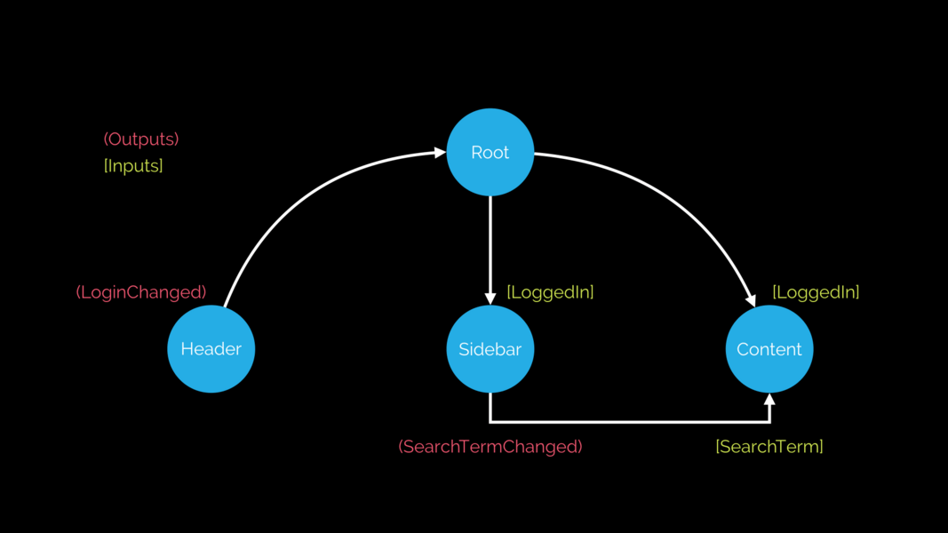
Component - Data Flow
<header (loginChanged)="loggedIn = $event"></header>
<sidebar (searchTermChanged)="searchTerm = $event"></sidebar>
<content [searchTerm]="searchTerm"></content>

Slide 58
Component- View Encapsulation
View Encapsulation : styles applied to only this component. (Shadow DOM applies view encapsulation)
@Component({ selector: ‘order-form',
template: ‘order-form-component.html',
styles: [`
.card {background-color: gray; }
` ]
})
Export class OrderFormComponent {
@Output() orderCreated = new EventEmitter<Order>();
createOrder(orderId:number, info: string) { this.orderCreated.emit(new Order(101,”shipment”)); }}

Slide 59
Component- View Encapsulation
The valid values for this config property are:
ViewEncapsulation.Native
ViewEncapsulation.Emulated
ViewEncapsulation.None.
(No encapsulation) (all cards grey as shadow DOM addes <style> .card {background:grey} </style> in head
The default value is ViewEncapsulation.Emulated
Observe HTML code on browser – ng-content-qwe-3….
Only for orderComponent but it can use global styles inherited.
.card[_ngcontent-qwe-3]{<style>.background:grey}

Slide 60
Component- View Encapsulation
ViewEncapsulation.Native
If we want Angular to use the shadow DOM we can set the encapsulation parameter to use ViewEncapsulation.Native like so:
(Our component is isolated from global styles)
@Component({ selector: ‘order-form', templateUrl: ‘order-form-component.html', styles: [ `.card { background-color: gray;}
` ],
encapsulation: ViewEncapsulation.Native})
Now other components can not access our styles (no leakage of styles) and also does not inherit global styles like bootstrap.css

Slide 61
Properties and Event bindings
{{ }} : angular expression (Interpolation)
[ ] : property binding
( ) : Event Binding
[( ngModel)] : Two way binding
*ngFor, *ngIf , *ngSwitch : structured directives
#variable : defining variable
let : to define variable ( Eg: *ngFor=“let item in items”)

Slide 62
DEMO TIME

Slide 63
Component
Component :
Component is a directive which uses shadow DOM to create encapsulate visual behavior. (also called Proto view)
Components are typically used to create UI widgets or to break up the application into smaller components.
Component's CSS selectors usually trigger on element names.
Component has its own shadow view which is attached to the element as a Shadow DOM.(React js - Virtual DOM)

Slide 64
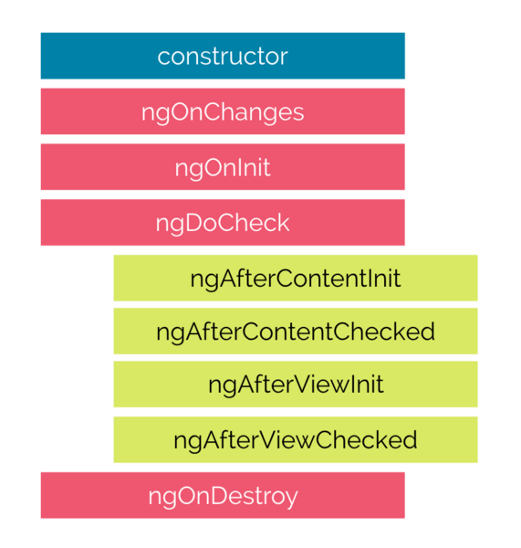
Component Lifecycle
A component in Angular has a life-cycle, a number of different phases it goes through from birth to death.
add some specific methods to component class which get called during each of these life-cycle phases called hooks.

Slide 65
Component
.
Constructor:
This is invoked when Angular creates a component or directive by calling new on the class.
ngOnChanges
Invoked every time there is a change in one of the input properties of the component.
ngOnInit
Invoked when given component has been initialized. This hook is only called once after the first ngOnChanges
ngDoCheck
Invoked when the change detector of the given component is invoked. It allows us to implement our own change detection algorithm for the given component.

Slide 66
Component
.
Hooks for the Component Children
ngAfterContentInit
Invoked after Angular performs any content projection into the components view.
ngAfterContentChecked
Invoked each time the content of the given component has been checked by the change detection mechanism of Angular.
ngAfterViewInit
Invoked when the component’s view has been fully initialized.
ngAfterViewChecked
Invoked each time the view of the given component has been checked by the change detection mechanism of Angular.

Slide 67
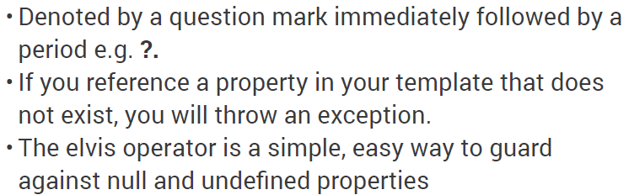
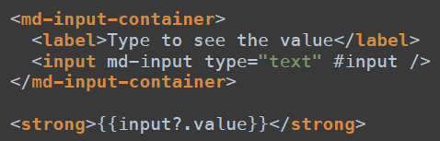
Angular –Elvis Operator

Slide 68
Angular – Pipe
Pipes (filters) - Services that transform values for display. We can put pipes in our templates to improve the user experience.
price | currency:'USD':true
displays a price of "42.33" as $42.33.

